Slide 1




Identification of Biomarkers for Personalized Medicine in Psoriatic Arthritis
A Project work submitted for the certification course Bio-informatics
Bversity
2024
David Franklin D

Slide 2
Table Of Contents
Topic, objectives
Research data
Methodology
Research findings
The methodology involved several key steps:
Introduction to Psoriatic Arthritis (PsA)
Data Acquisition
Centrality Genes
-01-
-02-
-03-
-04-

Slide 3

Part 01
Research Topic
Introduction to Psoriatic Arthritis (PsA)
Presentation are communication tools that can be used as demontrations, lectures, reports, and more. it is mostly presented before an audience.

Slide 4

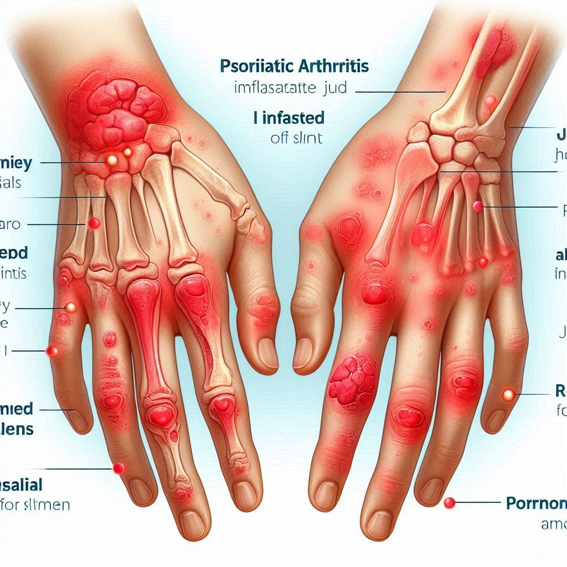

Research Topic
Introduction to Psoriatic Arthritis (PsA)
Psoriatic Arthritis (PsA)
It causes joint pain, stiffness, and swelling, leading to disability if untreated.
The chosen disease for the analysis is "Psoriatic Arthritis"
Problem Justification:
PsA is a chronic autoimmune disease affecting 30% of Psoriasis patients.
It presents significant challenges in treatment due to its complex pathophysiology and heterogeneity among patients. Traditional approaches to drug discovery often fall short in addressing the underlying molecular mechanisms driving the disease, leading to suboptimal treatment outcomes.

Slide 5
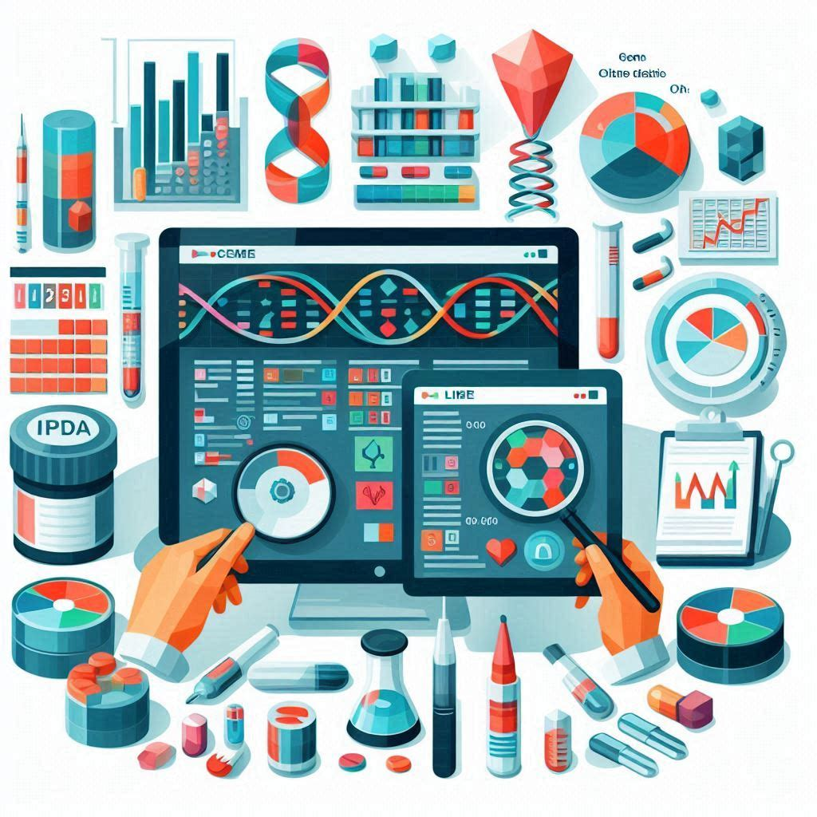

Research Objectives
Chossen Approach
Chosen Approach
To address these challenges, we used publicly available gene expression data from the NCBI Gene Expression Omnibus (GEO) database. By analyzing gene expression profiles from PsA patients and normal controls, we aimed to identify potential drug targets and biomarkers for personalized treatment strategies.
Breaking down this goal into steps:
Access and analyze gene expression data from the NCBI GEO database.
Identify differentially expressed genes (DEGs).
Conduct pathway analysis and functional annotation.
Identify potential drug targets.
Title here
Primary Goal:
Potential drug target identification
Utilize gene expression data to identify gene targets in PsA.

Slide 6
Part 02
Research Methodology
The methodology involved several key steps:

Slide 7
Research Steps
Differential Gene Expression Analysis- Work Flow Overview
Step 1: Data Acquisition and Pre-Processing
Step 2: Differential Gene Expression Analysis
Step 3 Pathway and Functional Analysis
Step 4
Hub Gene identification

Slide 8
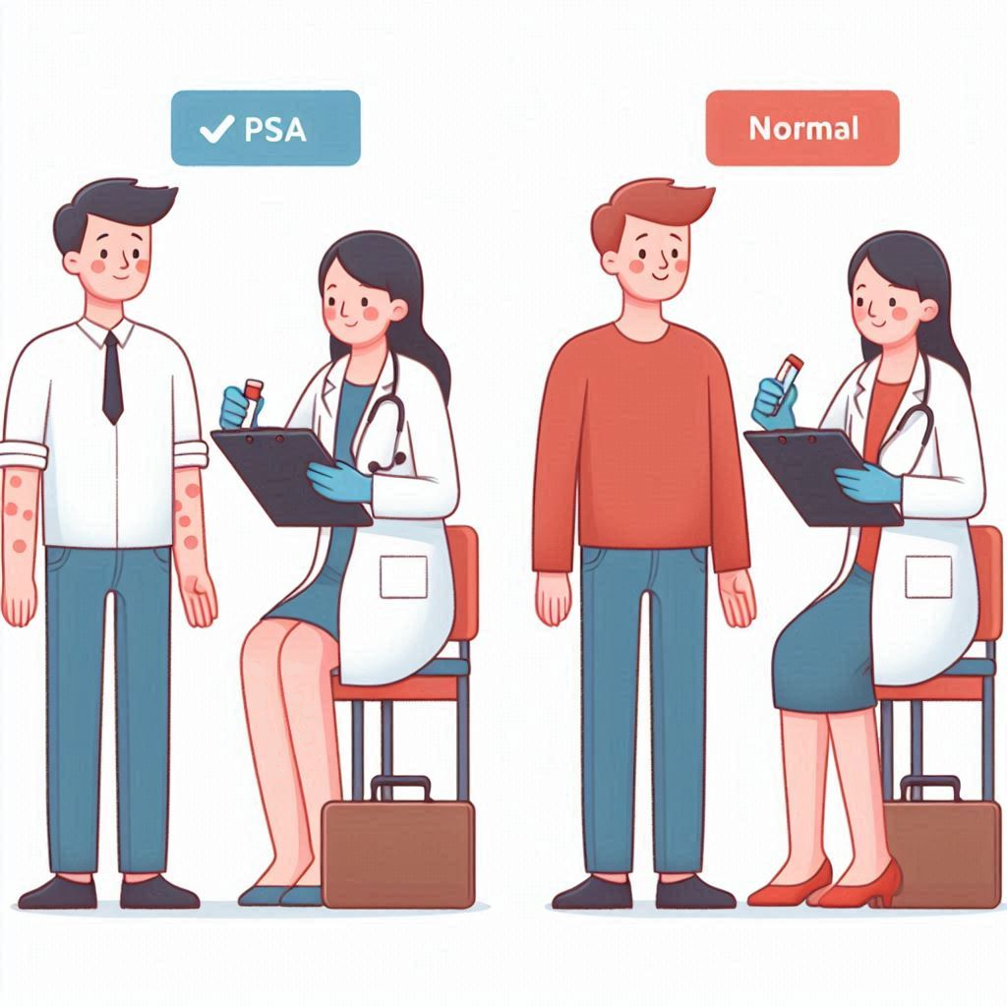
Research Step1
It serves a variety of purposes, making presentations powerful tools for convincing and teaching. It serves a variety of purposes, making presentations
Data Acquisition and Pre-Processing
Data Acquisition
- The Dataset GSE13355 was chosen for this analysis
- The Dataset contained gene expression of skin samples from PsA patients and skin control samples from healthy patients.
Data Pre-Processing
This ensured uniform data readability.
01
02
Robust Multichip Average(RMA)
Adjusted for batch and sex effects.
 | PsA patients | Healthy controls
Samples | 58 | 64
Normalized using Log scale
Marked using appropriate labels.

Slide 9
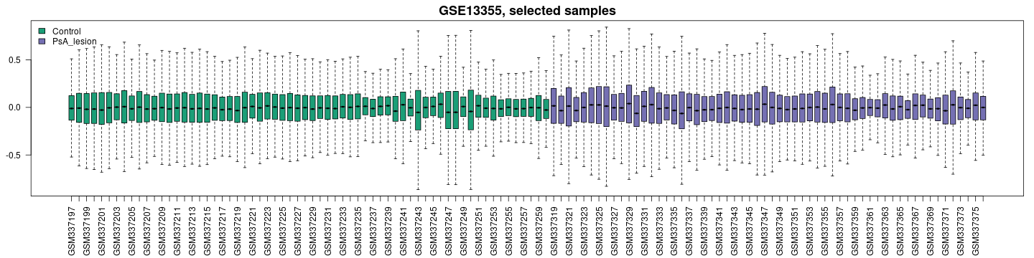
Research methods
Qulity Visualization
Visual- Lables
Analysis
Histogram Plot
The histogram shows graphical representation of the distribution of adjusted p-values for the genes in the datase.
The green for ‘Control’
and
purple for ‘PsA_lesion’.
It seems that both groups have a similar distribution of p-values.

Slide 10
Research Step2
Differential Gene Expression Analysis
Statistical Methods
'limma' package in R for analysis.
T-tests, ANOVA, and linear regression models to identify DEGs.
Multiple testing correction using False Discovery Rate (FDR).
Calculated LogFC values for relative gene expression matrices by using these methods , we identified differentially expressed genes (DEGs) between PsA patients and controls, shedding light on molecular alterations associated with the disease.
It serves a variety of purposes, making presentations

Slide 11
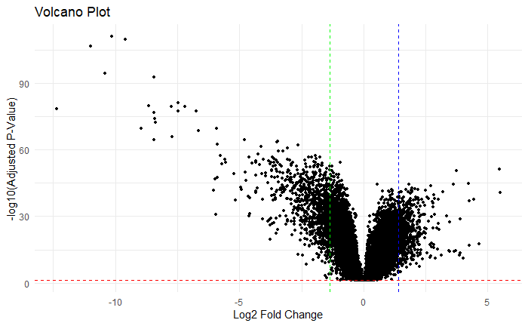
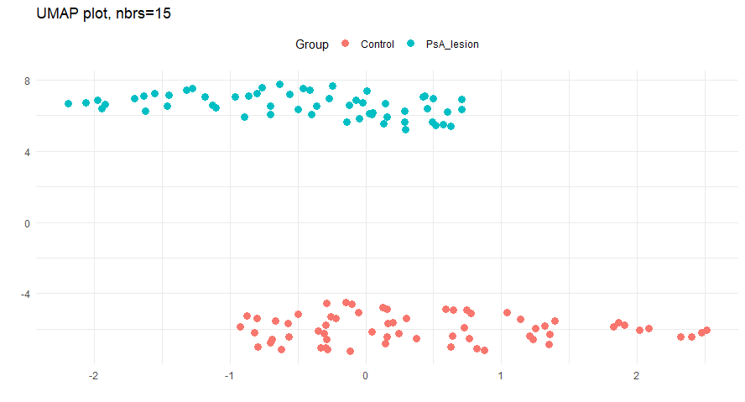
Research Step2
Differential Gene Expression Analysis
Volcano Plots
UMAP Plots
The UMAP plot visualizes samples in a two-dimensional space, where each point represents a sample, and the proximity between points reflects the similarity in gene expression profiles.
Highlight significant up- and down-regulated genes.
Only the significant genes were taken for further analysis. (dotted lines)

Slide 12
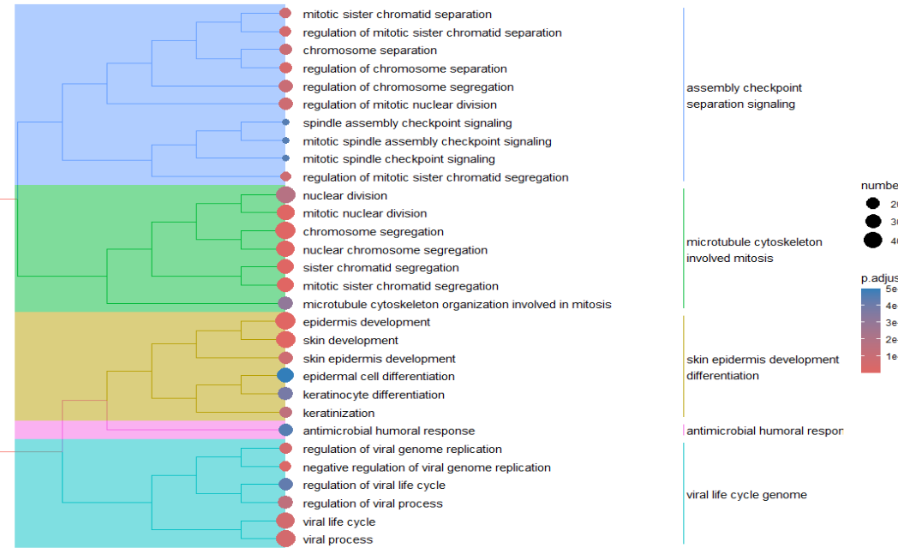
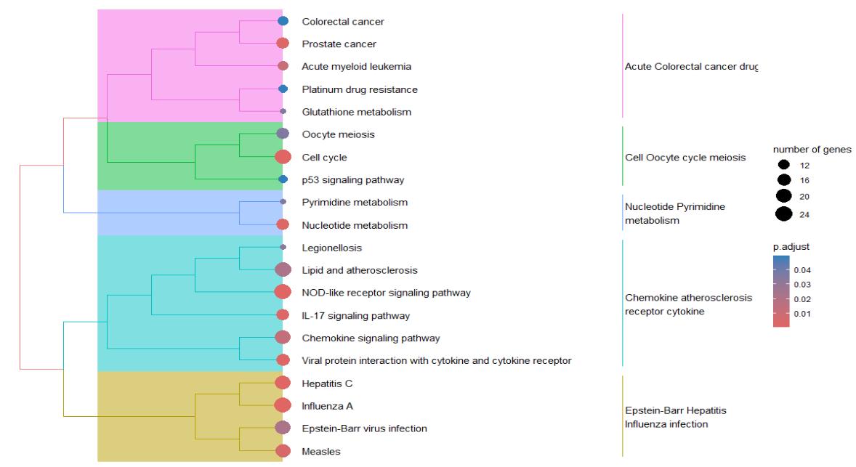
Research Step3
Pathway and Functional Analysis
Gene Ontology (GO) Analysis
KEGG Pathway Analysis
Processes with a large number of genes and low p-adjust values are particularly noteworthy for their potential role in PsA.
Processes with a large number of genes and low p-adjust values are particularly noteworthy for their potential role in PsA.

Slide 13
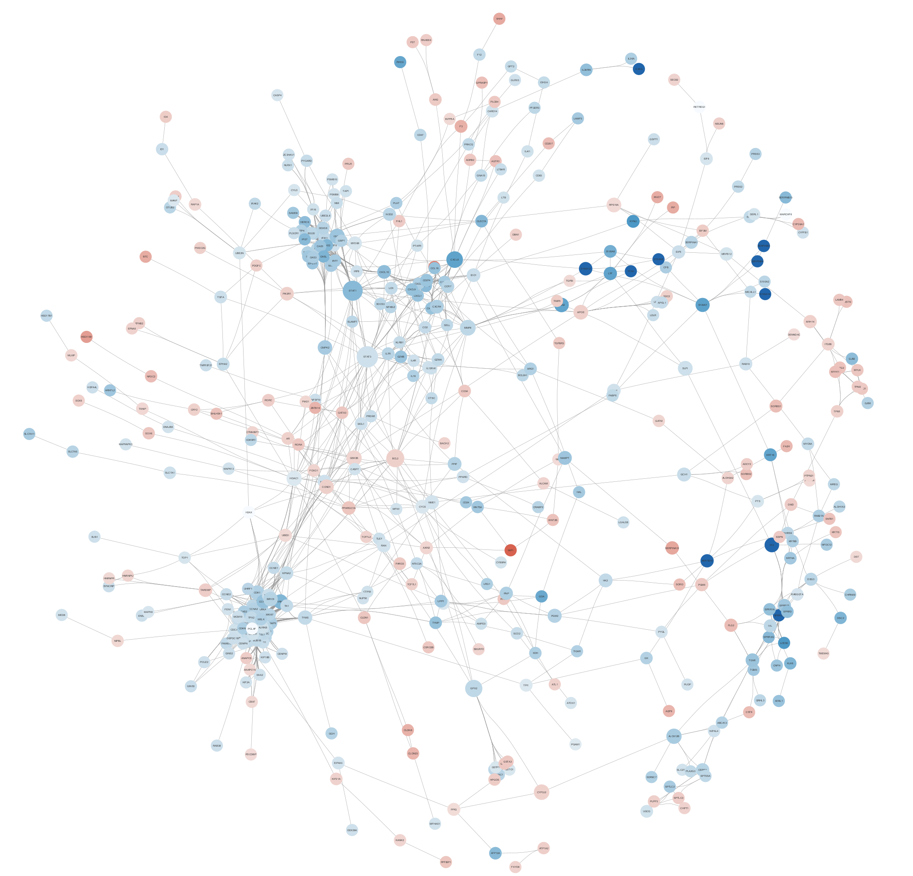
Research methods
Network Analysis
Cytoscape
Visualization Settings
Node Styling
- Fill Color | Log2FC (Continuous mapping: Blue for down-regulated, Red for up-regulated)
- Size | Betweenness (Continuous mapping)
- Border Paint | Degree (Continuous mapping with purple cutoff at 39, representing top hub genes)
Edge Styling
- Width | Combined Score (Continuous size)
Visualization Style | Ripple style
01
02
Cluster Analysis
Centrality
Proteins with a high degree of connectivity (hubs) could be key regulators or potential therapeutic targets.
The protein-protein interaction network visualized in Cytoscape represents the complex interplay between significant genes implicated in Psoriatic Arthritis (PsA).

Slide 14
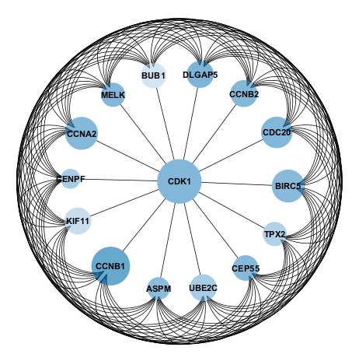
Research Step4
Hub gene Analysis
Hub gene
The cytoHubba of the Cytoscape software was used to select the significant hub genes among the obtained DEGs.
The Maximal Clique Centrality(MCC) method was used to select the top 15 genes of the PPI network.
Then, we used a connectivity degree in the PPI network to evaluate the top 15 genes we just selected.
Processes with a large number of genes and low p-adjust values are particularly noteworthy for their potential role in PsA.

Slide 15
Part 04
Research findings
Centrality Genes

Slide 16
Research findings
Potential Drug Targets
Differentially Expressed Genes
These DEGs provide insights into the molecular changes associated with PsA.
Enriched Pathways
Notable pathways include cell cycle regulation, immune response, and skin development.
Protein-Protein Interaction (PPI) Network
Hub genes within this network were identified as potential key players in PsA.

Slide 17
Research findings
Top 15 Maximal Clique Centrality Genes
Central Players (Hub Genes):
Rank | Name | Score | Gene.title | Log2FC
1 | CEP55 | 1.8 | centromere protein F | -2.5
1 | BIRC5 | 1.8 | baculoviral IAP repeat containing 5 | -2.5
1 | MELK | 1.8 | maternal embryonic leucine zipper kinase | -2.7
1 | KIF11 | 1.8 | kinesin family member 11 | -1.7
1 | ASPM | 1.8 | abnormal spindle microtubule assembly | -2.4
1 | CCNB2 | 1.8 | cyclin B2 | -2.6
1 | BUB1 | 1.8 | BUB1 mitotic checkpoint serine/threonine kinase | -1.6
1 | CDK1 | 1.8 | cyclin dependent kinase 1 | -2.7
1 | CCNA2 | 1.8 | cyclin A2 | -2.5
1 | CDC20 | 1.8 | cell division cycle 20 | -2.7
1 | UBE2C | 1.8 | ubiquitin conjugating enzyme E2 C | -2
1 | CCNB1 | 1.8 | cyclin B1 | -3.7
13 | KIF20A | 1.8 | kinesin family member 20A | -2.5
13 | CENPF | 1.8 | centromere protein F | -1.5
13 | TPX2 | 1.8 | TPX2, microtubule nucleation factor | -1.7
The high MCC scores of these genes indicate their central role in the PPI network related to Psoriatic Arthritis (PsA). Their central position suggests significant influence on the molecular mechanisms of PsA.
Their central position suggests they may be influential in the molecular mechanisms of PsA.
The negative Log2FC values indicate that these genes are downregulated in the condition being studied.
Potential Drug Targets: Given their central role in the network and involvement in cell cycle regulation, these genes could be potential targets for therapeutic intervention.

Slide 18
Research findings
Insert a catchy quote or valuable sentence here
Potential Drug Targets
It serves a variety of purposes, making presentations powerful tools
Statistical Analysis
Interper-tation
Clinical Implications
Personalized Treatment , Patient Stratification
Limitations
Potential biases in publicly available datasets, need for experimental validation.
Target Genes
Limitations
Future
Direction
Future Directions
Experimental Validations, Clinical Trials, Collaborations

Slide 19
THANK YOU
“The research illuminates the path from genetic insights to targeted therapies, promising a future where treatment is as unique as the individual."
A Project work submitted for the certification course Bio-informatics
Bversity
2024
David franklin D.

